Slide 1
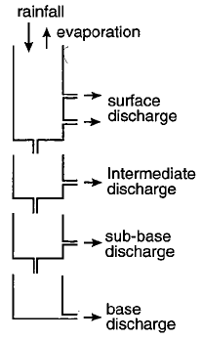
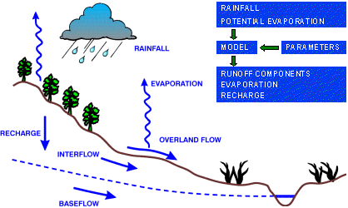
Example: catchment – a system and its model lumped conceptual rainfall-runoff model, based on cascades of reservoirs
Tank model of Sugawara (1961)
NAM (DHI)
HBV (SMHI)

Slide 2
A simple lumped conceptual model of Sugawara (1961) (2-tank version)
eight parameters
initial levels s1, s2
elevations of outlets: d1,d2
conveyance coeffs: k1, k2, k3, k4
they cannot be measured, so have to be calibrated
Q: what are the
model inputs?
internal states?
outputs?

